Slide 1

Chemistry Presentation
BY :
HAFIZ RAHMAN
IZZAT HAIKAL
HAZIM ADNAN
NIK ABDUL
YUSUF RITWAN
HAFIZUDDEN
IRFAN RAZUKI
What are we going to learn today?

Slide 2
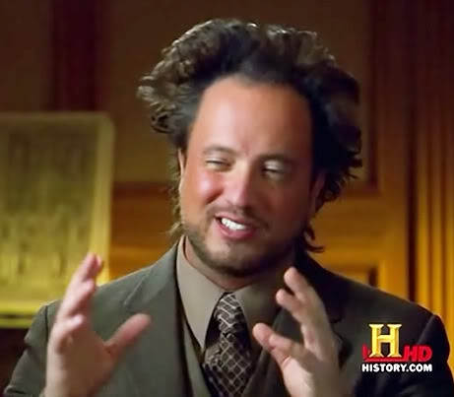
IONIC BOND

Slide 3

What is Ionic Bond???

Slide 4

An ionic bond is a type of chemical bond formed through an electrostatic attraction between two oppositely charged ions. Ionic bonds are formed between a cation, which is usually a metal, and an anion, which is usually a nonmetal.
The electrons in the outer shell of the metal atoms are transferred to the non-metal atoms.
They have an electron configuration of a noble gases.
The strong force of attraction between the oppositely charged positive and negative ions results in an ionic bond.
Also called an electrovalent bond.
Ionic bond is very strong.
(refer to wikipedia or textbook)

Slide 5

HOW ARE IONS FORMED ?
Positive ions formed when an atom loses one or more electrons. Metal atoms usually lose electrons and form positive ions.
Negative ions are formed when an atom gains one or more electrons. Non-metal atoms usually gain electrons and form negative ions.
The charge of the ions depends on the number of electrons lost or gained.

Slide 6
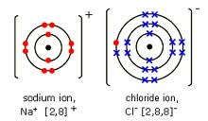
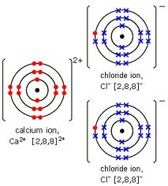
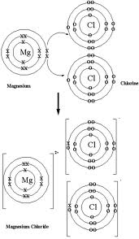

DOT AND CROSS DIAGRAMS

Slide 7
Ionic Molecules Properties
STATE
Due to strong forces of attraction, all the ionic compounds are exist in solid state.
THERMAL STABILITY
Ionic compounds have high melting points and boiling points.
CONDUCTANCE
They are strong electrolytes. In solid state they do not conduct electricity. But in molten state and in aqueous solution they conduct electricity.
SOLUBILITY
Generally ionic compounds are soluble in water and in many polar solvents.
Ionic compounds are insoluble in the organic compounds.
HARDNESS
They are very hard.
REACTIVITY
Generally ionic compounds are very reactive .
NON-MOLECULAR FORM
Ionic compounds do not exist in the forms of molecules. Their formula only indicates the number of atoms present in the compound.

Slide 8

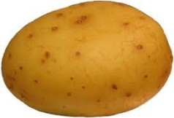
long presentation?,take this potato…

